Slide 1

Walmart Sales Prediction with R Programming
Project by: Pravat Kumar Sahu
Mentor: Deepti Gupta
Simplilearn Batch: PGP DA FEB 2021 Cohort 1
May 13, 2021

Slide 2
Introduction
The project is about Walmart Retail stores and to analyze how various internal and external factors can affect its sales. This project tries to achieve an approximate weekly sales prediction by looking at past year’s performance for each Store.
The historical data is collected from year 2010 to 2012 for 45 Walmart stores in US and are included in this analysis. The data has other information such as store number, date, holiday flag, temperature, fuel price, consumer price index and unemployment rate for the region.
There are 6435 observations and 8 variables in the data. All the variables are integer or number except for date variable which is in character format.
Problem:
Walmart runs several promotional markdown events through out the year. These events are preceded four major holiday season in US. Walmart is running out of stocks during the holiday weeks due to unforeseen demands and facing challenges in filling demand and supply gap and inventory management. This is due to lack of historical data and use of inappropriate Machine Learning (ML) Algorithm causing failure in predicting right sales during the holiday weeks.
Solution:
In this project we will build an appropriate model to fix the problem. The dependent variable would be weekly sales and independent variables would be all other variables (store number, date, holiday flag, temperature, fuel Price, consumer price index and unemployment rate).

Slide 3
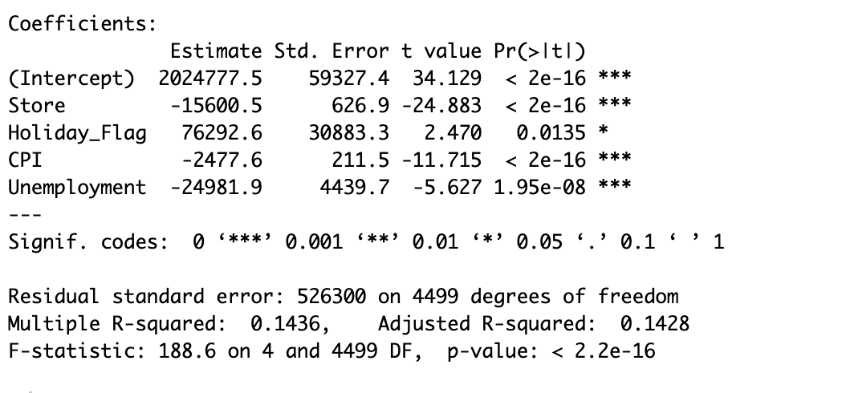
Supervised Machine Learning (ML) – Multiple Linear Regression Model
Multiple Linear regression model is one of the supervised machine learning model which is used when the data has one dependent variable and more than one independent variables. The prediction is done for the dependent variable based on independent variables. Running the regression model will produce the coefficient table. We will study the table after removing the non-significant independent variables and include only significant ones.
Significant Independent variables are Store number, Holiday_Flag, CPI, Unemployment as their P value is less than 0.05.
Slope of the significant variables are positive for Holiday_Flag and negative for Store number, CPI and Unemployment.
Holiday_Flag is positively co-related to weekly sales. In other word, we can say that weekly sales increases by 76292 for per each holiday weekday flagged as 1.
Store number is negatively co-related to weekly sales. In other word, we can say that weekly sales decreases by 15600 as the numbers increases.
CPI is negatively co-related to weekly sales. In other word, we can say that weekly sales decreases by 2477 for 1% increase in prevailing consumer price index.
Unemployment is negatively co-related to weekly sales. In other word, we can say that weekly sales decreases by 24981 for 1 % increase in unemployment rate in the region.
Now let’s look at R squares measures. R square is a relative measure of fit and it is the measure of the linear relationship between our independent and dependent variable. From the result we found out that R square is 14.36% and Adjusted R square is 14.28% which explains roughly 14% variance or change in weekly sales is explained by the above 4 significant variables which is very low. Result above 70% is should be a cut off and is a good indicator of the model. So, in this case we can say that model is still not well fitted with the actual data.

Slide 4
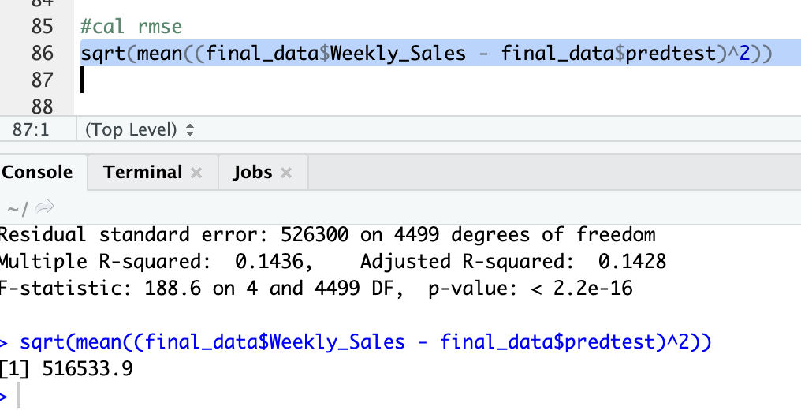
RMSE or Prediction of the Model
Now let’s check the RMSE. RMSE is an absolute measure of fit. The RMSE is the square root of the variance of the residuals or errors. It indicates how accurate the model is or, how close observed data compared to the model’s predicted values. The lower the values of RMSE, the better is the model accuracy or model’s prediction. In our study we observed that RMSE value is too high which again explains that the model is not doing good job in prediction. This is could be due to lack of adequate history or variables or richer data which if it is available to our study might help in improving good prediction about future sales of 45 stores of Walmart.

Slide 5

Conclusion
From our study it is concluded that more richer data are required to in order to apply appropriate machine learning algorithm to predict accurate future sales which will help Walmart to effectively managing each stores inventory and fix the the demand and supply gap problem. This is ultimately will lead to customer satisfaction and successful revenue generation for Walmart.
We can further study by going for any other machine learning algorithm model to see if other models also produces similar results. If other models too produces meaning less results it is quite clear that this dataset requires more variables which are require for producing a meaningful study.
R codes embedded in the below word file.

